Slide 1

Import Export Website Tracking Result –Final
https://Importexport3.com

Slide 2
Key Metrics for KPIs
User : New
User : Returning user
Avg Session Duration (conversion rate)
Number of session per user
Bounce Rate
Pageviews

Slide 3
Key Performance Indicator
Online Visibility
Customer satisfaction
One of the Top Import-Export website.

Slide 4
Improvement After First Version
Keyword optimization
Website layout changes
Addition of more content

Slide 5
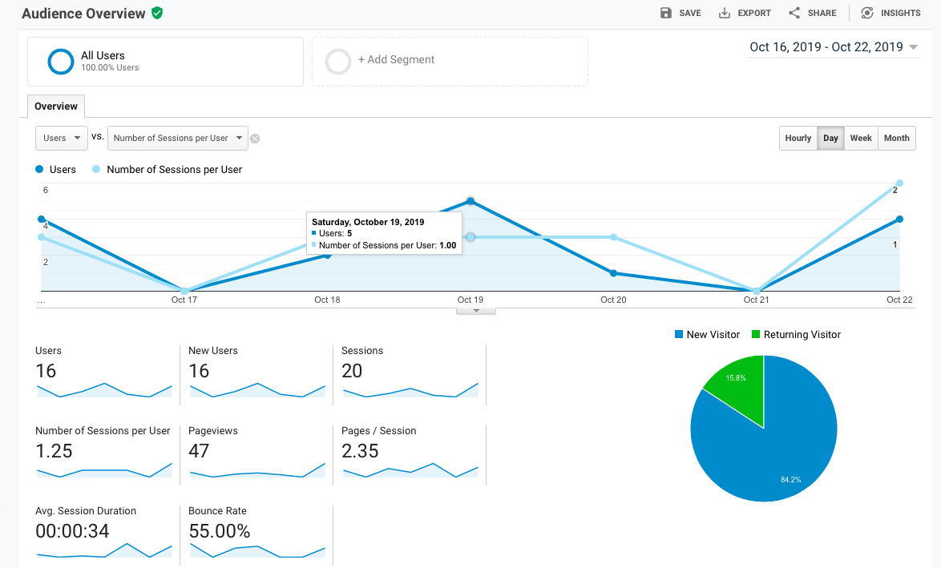
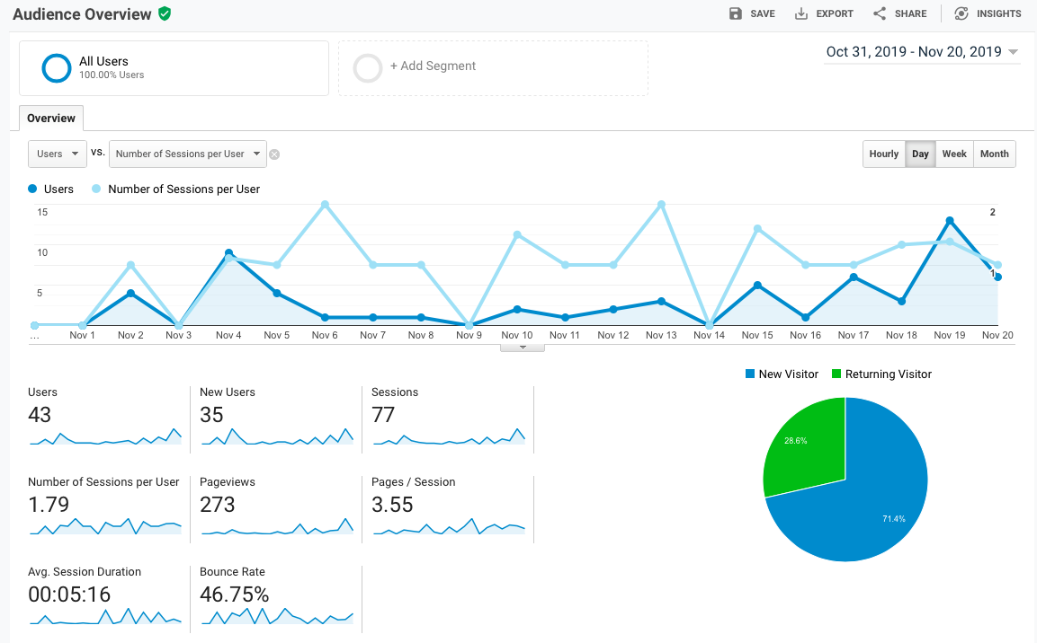
Audience Overview

Slide 6
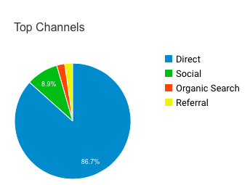
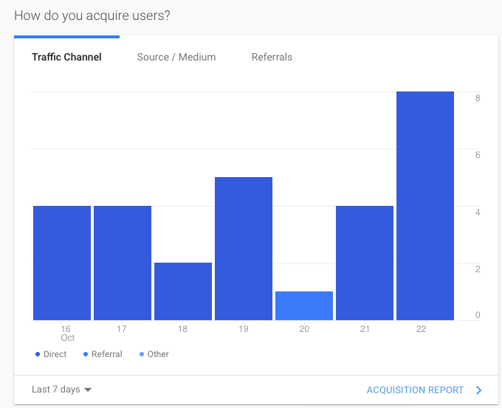
Users Sources
Direct
Referral
other

Slide 7
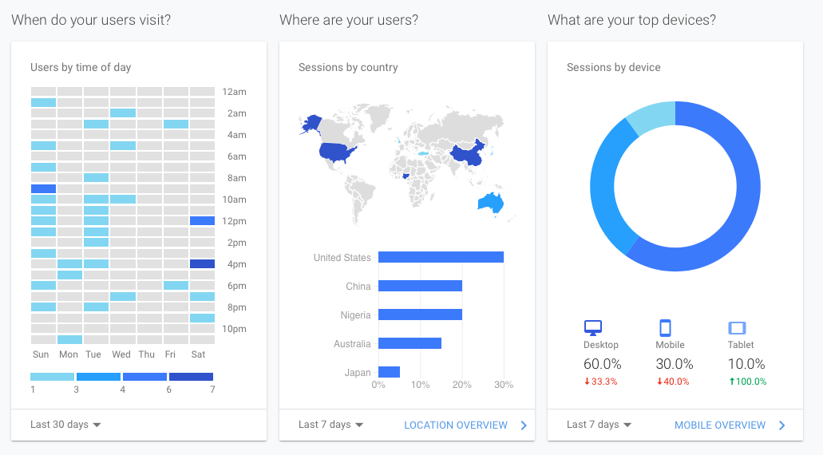

Slide 8
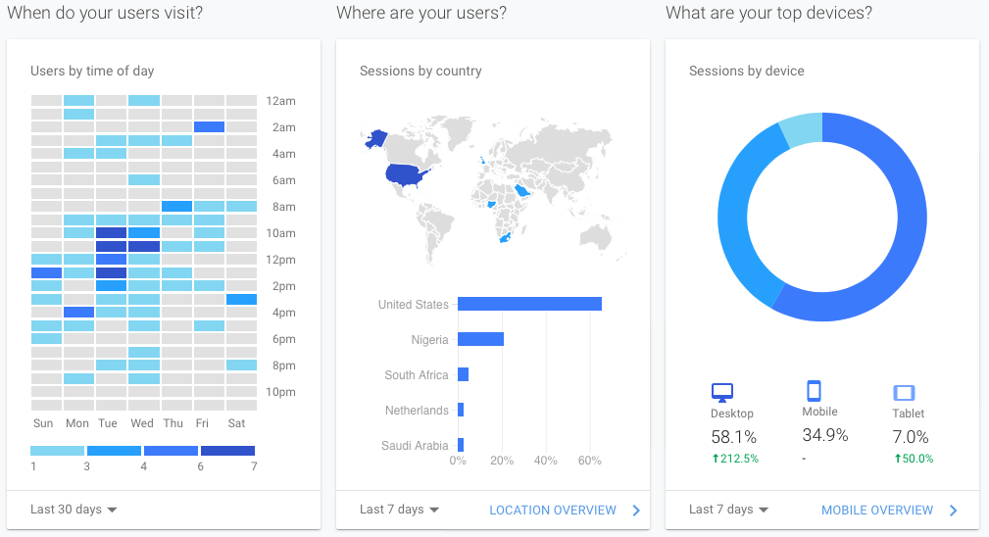

Slide 9
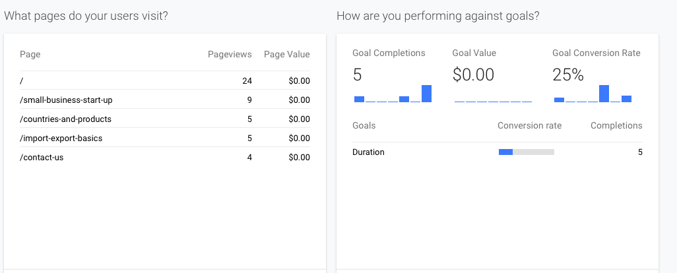
Goals and Conversion Rate
Performance

Slide 10
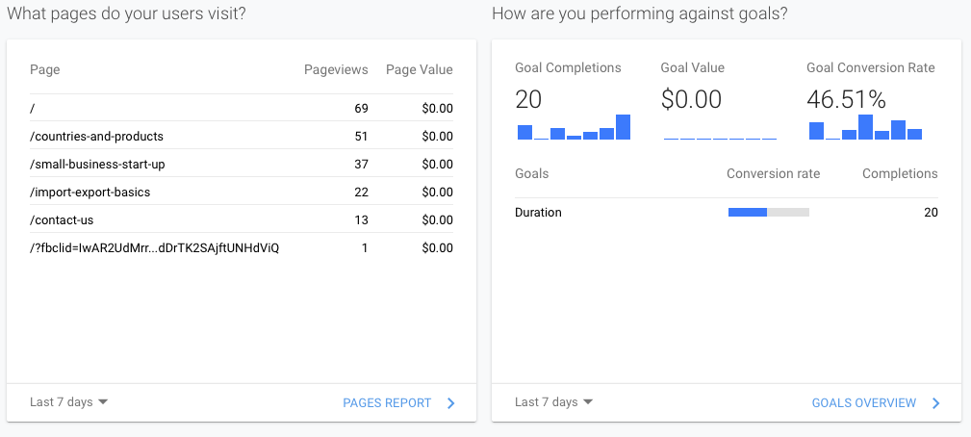
Goals and Conversion Rate
Performance

Slide 11
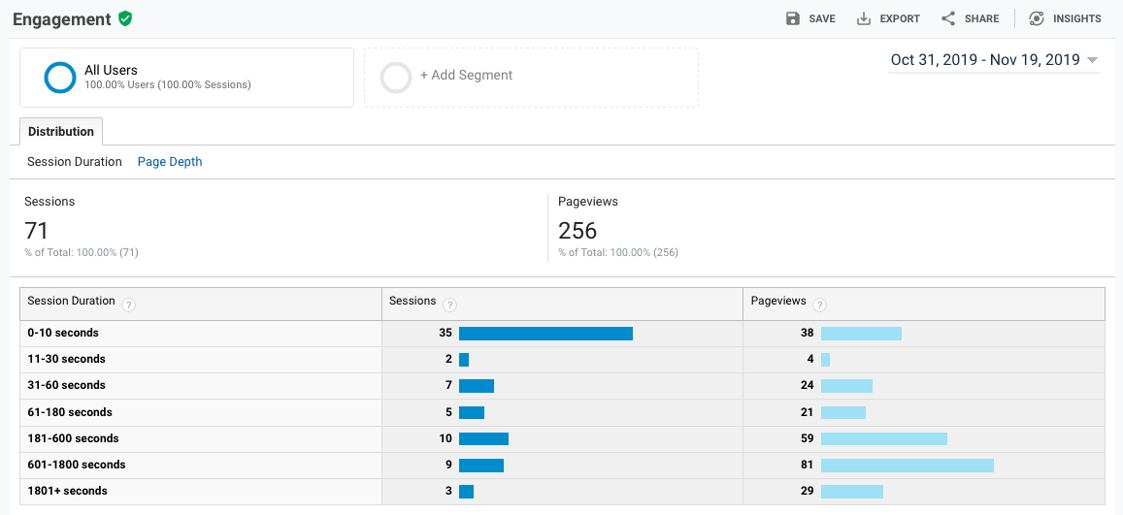

Slide 12
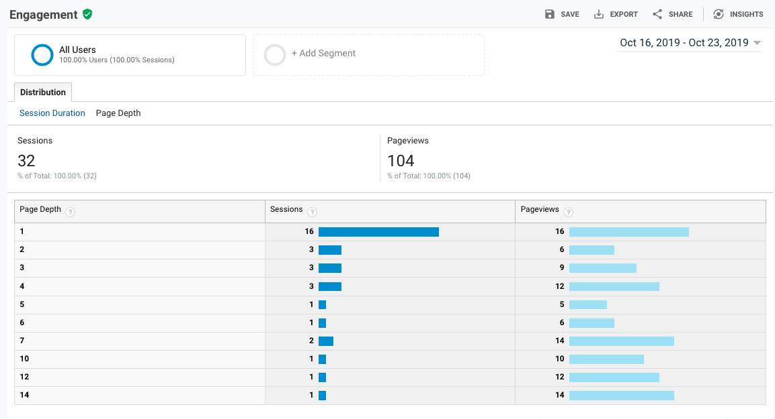

Slide 13
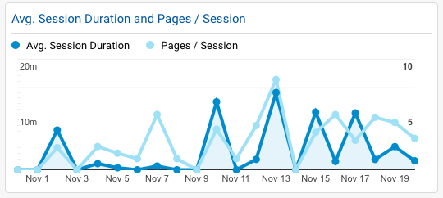
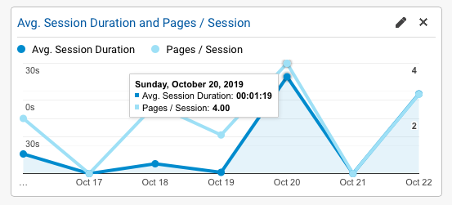
Page Depth
Pages/session

Slide 14
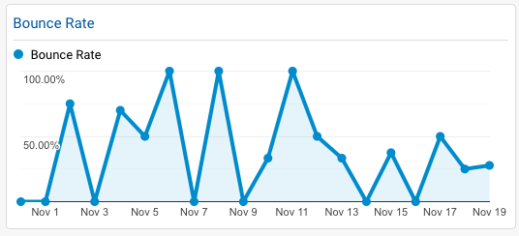
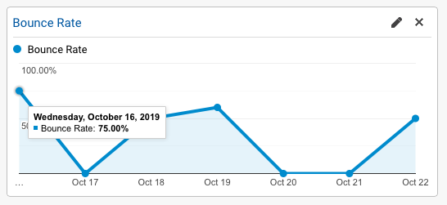
Bounce Rate

Slide 15
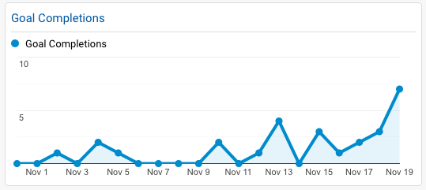
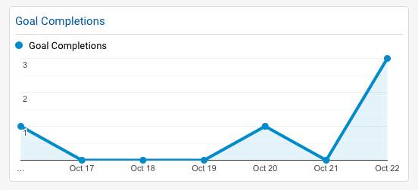
Goal Achievement

Slide 16
Increase Referral and social user sources Addition of more KEYWORDS Content detail optimization Feature optimization
Improvements Required

